Slide 1
Portfolio Project 2: Responsive Website
Bethany Morgan Woodard

Slide 2
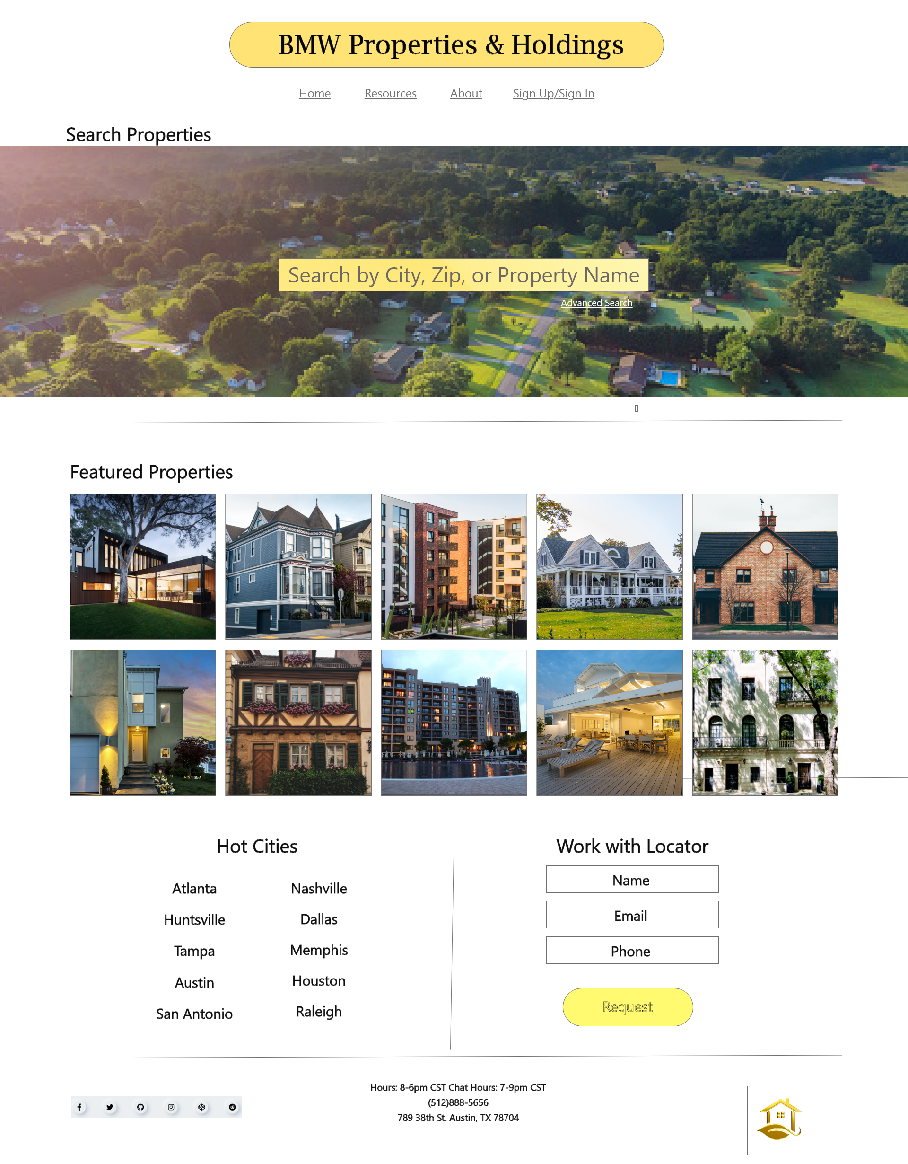
Project overview
The product:
A website designed to assist users in their online property search; whether it be rentals, buyers, sellers or investors—this website aims to help users achieve their goals
Project duration:
June 2022 to July 2022

Slide 3
Project overview
The problem:
The rental market is booming and extememly competitive. Things move quickly and many potential users can be overwhelmed by this environment. Many online search websites offer one service or another..
The goal:
With this responsive website, potential users can receive comprehensive assistance navigating the ins and outs of real estate; offering both convenience and support.

Slide 4
Project overview
My role:
UX researcher/designer leading the BMW Properties and Holdings website design
Responsibilities:
User Research, Comparative Analysis, Conducting interviews, paper and digital wireframing, low and high-fidelity prototyping, conducting usability studies, accounting for accessibility, iterating on designs and responsive design.

Slide 5
User research
Personas
Problem statements
User journey maps
Understanding
the user

Slide 6
User research: summary
I conducted user interviews, which I then turned into empathy maps to better understand the target user and their needs. I discovered that many target users are using online platforms to conduct their own property research. However, many real estate geared websites are overwhelming and confusing to navigate, which frustrated many target users. This caused a sometimes time sensititive task to lead to missed opportunities, paying too much or causing undue stress. By offering a multitude of services and research resources, users can potentially improve their options, save money and worry less!

Slide 7
User research: pain points
1
2
3
4
Navigation
Interaction
Experience
Budget
Many property search websites can be cluttered and may offer disjointed user flow. My goal was to ensure potential users could move through the website without guidance.
Limited searching options may lead to missed opportuinities. My goal is to have many different ways to search for properties so that potential users have diverse options.
Other property search websites may not have engaging browsing. My goal is to offer many resources and available agents for one on one support. This allows for peace of mind and convenience.
In this competitive market, this is a top proiortity regardless if the user is a buyer, seller, renter or investor. There is always a number in mind and it is a goal of the website to prioritize this as well.

Slide 8
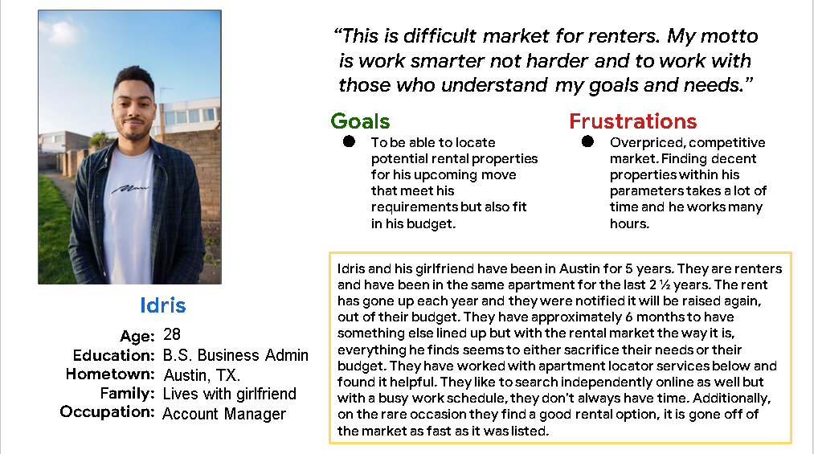
Persona: Idris
Problem statement:
Idris is a 28 year old working professional
who needs Help finding a rental property for he and his girlfriend to move into when their lease is up in 6 months because the rental market is expensive and competitive at this time and he has not been able to find a place that meets his needs and his budget.

Slide 9
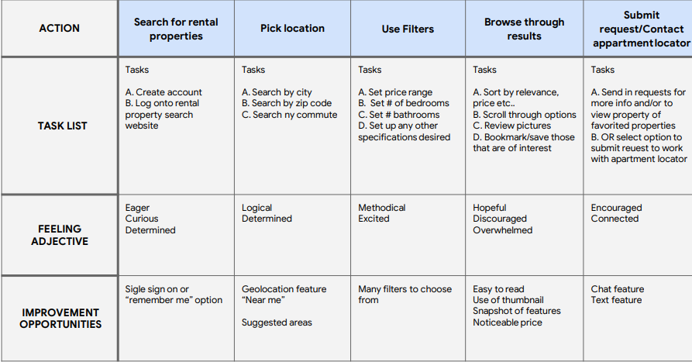
User journey map
I created a user journey map of Idris’ experience using the site to help identify possible pain points and improvement opportunities.

Slide 10
Sitemap
Paper wireframes
Digital wireframes
Low-fidelity prototype
Usability studies
Starting
the design

Slide 11
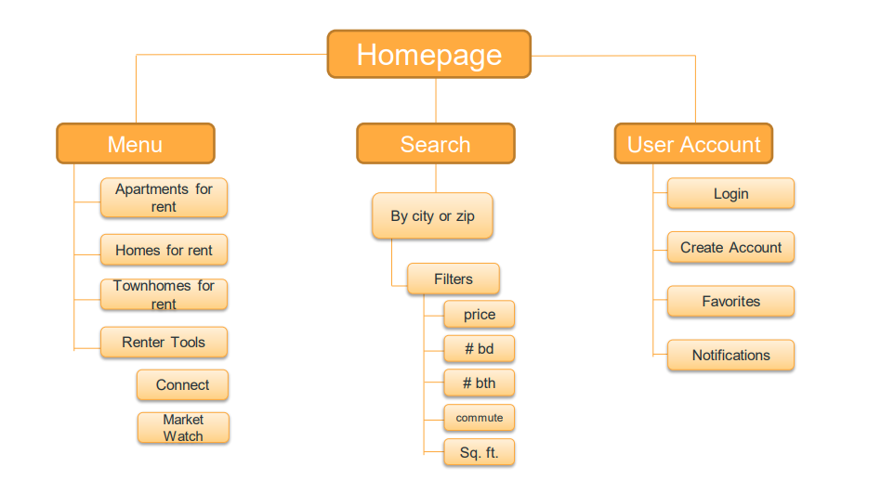
Sitemap
Difficulty with website navigation and resources offered were primary pain point for users, so I used that knowledge to create a sitemap.
My goal here was to make strategic information architecture decisions that would improve overall website navigation. The structure I chose was designed to make things simple and easy.

Slide 12
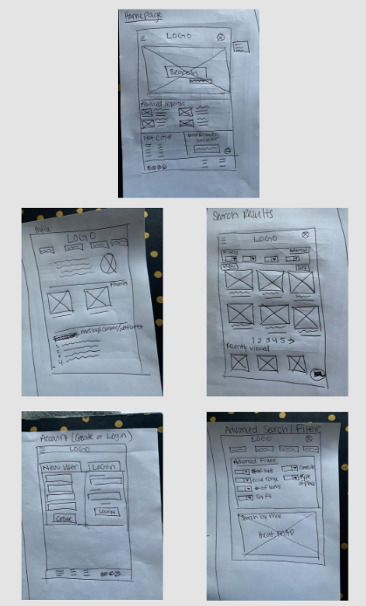
Paper wireframes
Next, I sketched out paper wireframes for each screen in my app, keeping the user pain points about navigation, browsing, and checkout flow in mind.
The home screen paper wireframe variations to the right focus on optimizing the browsing experience for users.

Slide 13
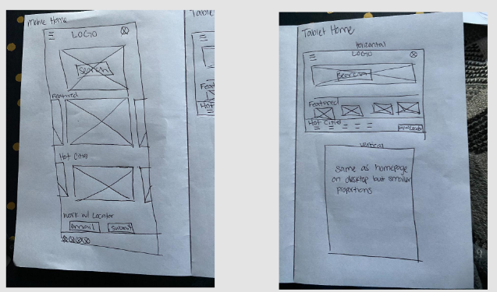
Paper wireframe
screen size variation(s)
Because BMW Properties & Holdings customers access the site on a variety of different devices, I started to work on designs for additional screen sizes to make sure the site would be fully responsive.

Slide 14
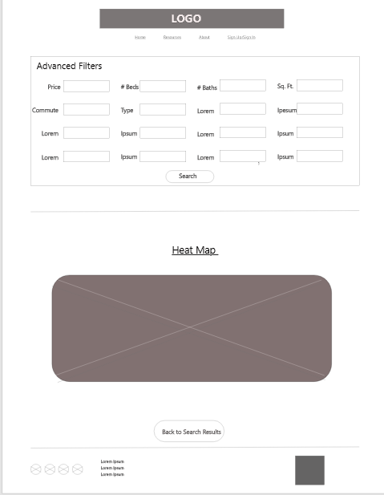
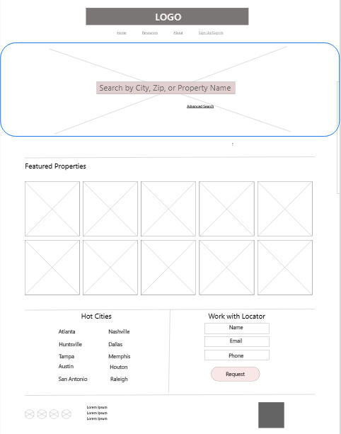
Digital wireframes
Moving from paper to digital wireframes made it easy to understand how the redesign could help address user pain points and improve the user experience.
Prioritizing visual element placement on the home page was a key part of my strategy
Heat Map really aids in accesibility, offering visuals to help digest the information for some users
Unique search options to provide comprehensive results
Option to work with BMW P&H property locator to provide support and resources

Slide 15
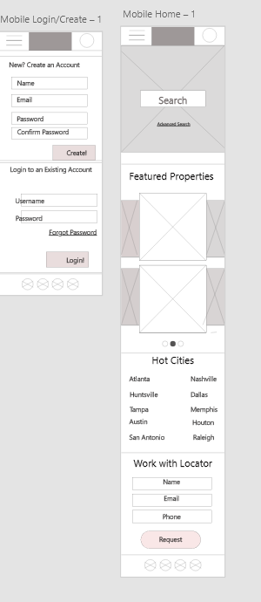
Digital wireframe
screen size variation(s)
For accessibility purposes, it was a goal of mine to map out a digital wireframe for an alternative screensize. I chose to go with a mobile format as most users rely on this medium for convenince purposes; which was a major pain point in my research.

Slide 16
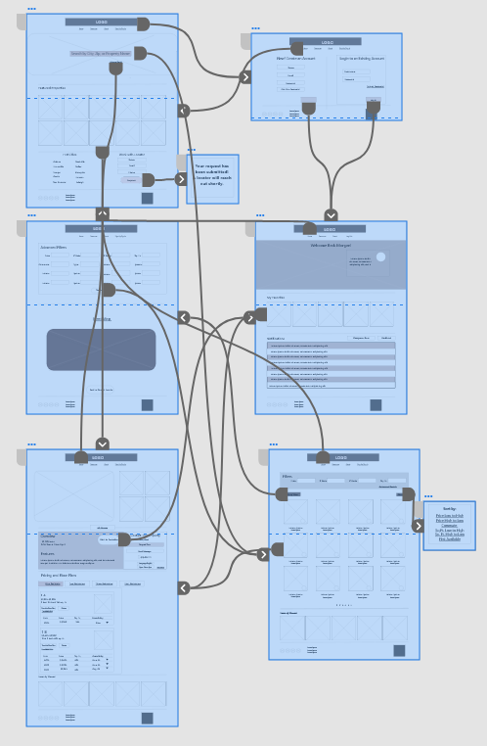
Low-fidelity prototype
To create a low-fidelity prototype, I connected all of the screens involved in the primary user flows of signing in, searching for a property, reviewing that property and contacting a locator.
At this point, I had iterated several different flows to give the users options in the upcoming usability study. I implemented several actions in places that addressed user pain points.
View: https://xd.adobe.com/view/619430ff-6839-4011-8678-58e6940ff1d9-34c7/?fullscreen

Slide 17
Usability study: parameters
Study type:
Unmoderated usability study
Location:
Texas, United States, remote
Participants:
4 participants
Length:
10 minutes

Slide 18
Usability study: findings
These were the main findings uncovered by the low fidelity usability study:
1
2
3
Navigation
Support
Resources
Most users were able to follow the user flow easily and complimented the design
Most users are interested in potentially working with a locator
Half of users will notice the heat map feature and find it unique and helpful

Slide 19
Refining
the design
Mockups
High-fidelity prototype
Accessibility

Slide 20
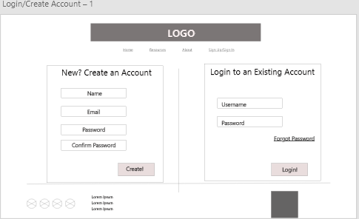
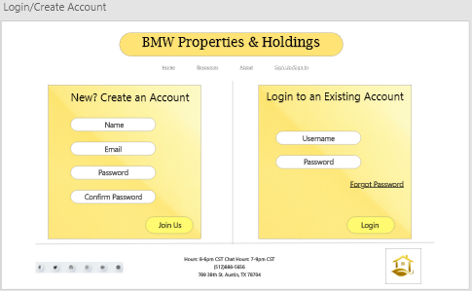
Mockups
Based on the feedback from my usability study, I made the design more aesthetically consistent and added color that was attractive but not overpowering. I also implemented a more professional look to the buttons.
Before usability study
After usability study

Slide 21
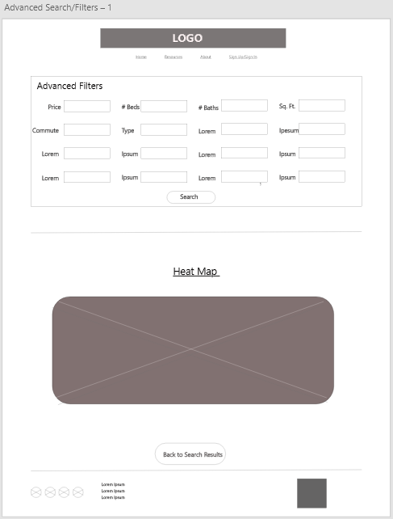
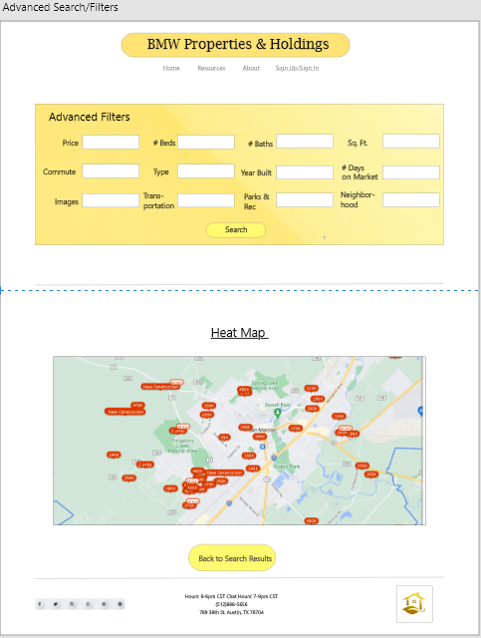
Mockups
Based on the insights from the usability study, I made changes to improve the advanced search filter to only include practical but unique features to aid in providing the best search results for potential users. I also added the heat map image to really highlight the user flow.
Before usability study
After usability study

Slide 22
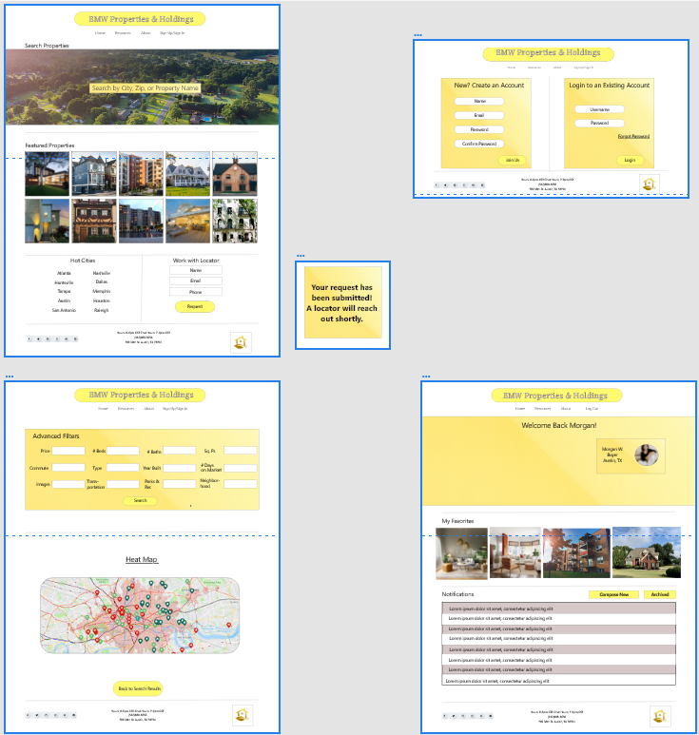
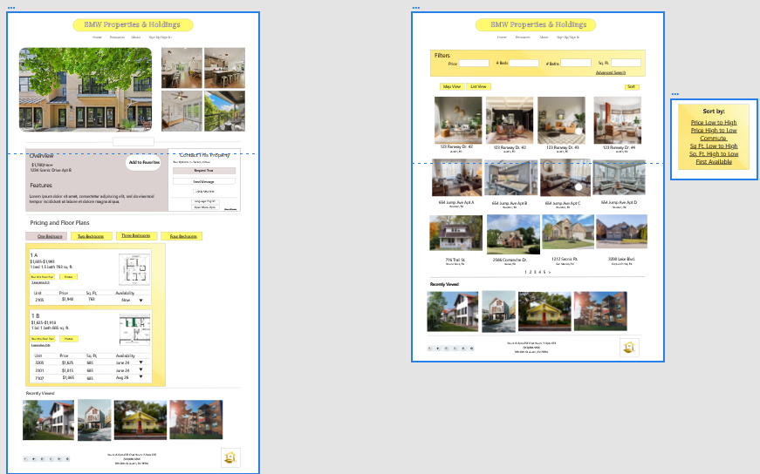
Mockups: Original screen size

Slide 23
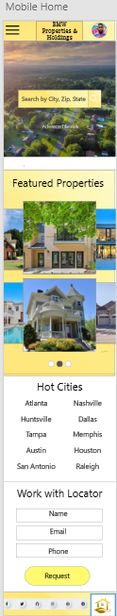
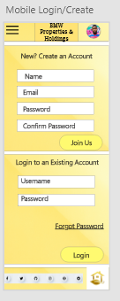

Mockups: Screen size variations
I included considerations for additional screen sizes in my mockups based on my earlier wireframes. Because users shop from a variety of devices, I felt it was important to optimize the browsing experience for a range of device sizes, such as mobile and tablet so users have the smoothest experience possible.

Slide 24
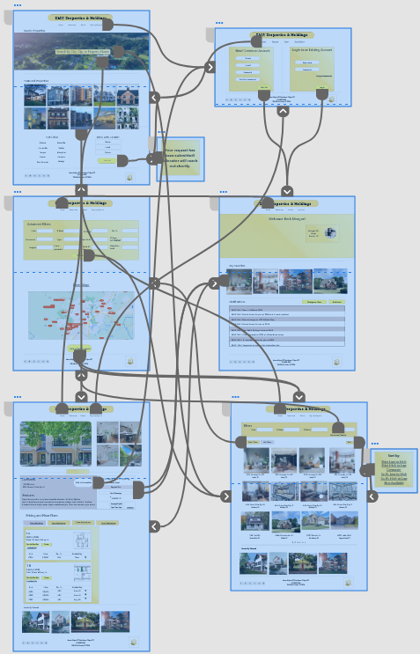
High-fidelity
prototype
My hi-fi prototype followed the same user flow as the lo-fi prototype, and included the design changes made after the usability study.
View: https://xd.adobe.com/view/78f3b291-2208-4f9a-83c3-528351bb5074-2da0/?fullscreen

Slide 25
Accessibility considerations
1
2
3
I used headings with different sized text for clear visual hierarchy
I used landmarks to help users navigate the site, including users who rely on assistive technologies
I designed the site with alt text available on each page for smooth screen reader access

Slide 26
Going forward
Takeaways
Next steps

Slide 27
Takeaways
Impact:
Our target users shared that the design was intuitive to navigate through, more engaging with the images, and demonstrated a clear visual hierarchy.
What I learned:
I learned that even a small design change can have a huge impact on the user experience. The most important takeaway for me is to always focus on the real needs of the user when coming up with design ideas and solutions.

Slide 28
Next steps
1
2
3
Focus more on the communication aspect between professionals and users
Conduct follow-up usability testing on the new website
Identify any additional areas of need and ideate on new features

Slide 29
Let’s connect!
Thank you for reviewing my work on the BMW P&H property search app!
If you’d like to see more, or would like to get in touch, my contact information is provided below:
Email: bethanymwoodard@gmail.com
Website: https://morganwoodard19.wixsite.com/iambmw

